Slide 1
Computer Graphics labs
Lab 1 - Shaders & Project Setup

Slide 2
Project Structure
01
Source Code
Contains Code written by us.
Can contain one or more entry points.
02
Libraries
Code not written by us.
Contains: GLFW, GLAD, GLM, STB, etc.
03
Assets
Files that are not C++ code.
Contain models, images, shaders, etc.
04
CMake Configuration
Define how the code will be built together.

Slide 3

OpenGL-Examples Project Structure
source: for all the c++ code written by us.
vendor: for all the external libraries we use.
Project
Folder
assets: for all the non-c++ files.
CMakeLists.txt

Slide 4
Minimal CMakeLists.txt example
cmake_minimum_required(VERSION 3.0.0)
project(minimal_project VERSION 0.1.0)
add_executable(application main.cpp)
# this is a comment
Project Name and Version
Executable file name and which file to compile for building this executable
Notes:
At least we need to define the minimum cmake version, the project name & version and one target which can be an executable or a library.
Each target can be built from one or more c++ files.
Note that the executable name will be “application” although the project name is “minimal_project”. In addition, we can have more than one target.

Slide 5
Minimal CMakeLists.txt example
cmake_minimum_required(VERSION 3.0.0)
project(minimal_project VERSION 0.1.0)
add_executable(application main.cpp path/to/other.cpp)
# this is a comment
You can add more files if needed.
Notes:
Each target can be built from one or more c++ files. The files can only have one main function only.

Slide 6
Minimal CMakeLists.txt example
cmake_minimum_required(VERSION 3.0.0)
project(minimal_project VERSION 0.1.0)
add_executable(application main.cpp path/to/other.cpp)
add_executable(application2 main2.cpp path/to/other.cpp)
Another Executable Target
Notes:
We can have more than one target. From this configuration, we can deduce that either of the following is true:
1- main.cpp and main2.cpp each have a main function but path/to/other.cpp doesn’t have a main function.
1- path/to/other.cpp has a main function but (main.cpp and main2.cpp) both don’t have a main function.
If more than or less than one main function is defined for an executable, an error will be thrown.

Slide 7
Minimal CMakeLists.txt example
cmake_minimum_required(VERSION 3.0.0)
project(minimal_project VERSION 0.1.0)
add_library(library STATIC path/to/other.cpp)
add_executable(application main.cpp)
target_link_libraries(application library)
add_executable(application2 main2.cpp)
target_link_libraries(application2 library)
Static Library Target
Link the static library with the executables
Notes:
Sometimes, it is desired to compile some pieces of code once and turn them into a static library. Then the library can be linked to the executable by the linker.
Note:
Static libraries are used during linking to retrieve pieces of code that the executable needs. If a needed static library is missing, a linking error will occur. On windows, they usually have the extension “.lib”.
Dynamic libraries are loaded in runtime by the executable. If a needed dynamic library is missing, a runtime error will occur. On windows, they usually have the extension “.dll”.

Slide 8
Minimal CMakeLists.txt example
cmake_minimum_required(VERSION 3.0.0)
project(minimal_project VERSION 0.1.0)
add_subdirectory(path/to/folder)
add_executable(application main.cpp)
target_link_libraries(application other_library)
Path to a folder containing another CMakeLists.txt
Linking a target built by another CMakeLists.txt
Notes:
Here we are adding a subdirectory that contains another CMakeLists. That included CMakeLists can have its own targets. If any of these targets is a library, we can link it to one of our targets using it name.

Slide 9
Minimal CMakeLists.txt example
cmake_minimum_required(VERSION 3.0.0)
project(minimal_project VERSION 0.1.0)
include_directories(path/to/includes)
add_executable(application main.cpp)
#include <file1.h>
#include "file1.h"
Path is searched for in include_directories
Path is relative to source file path
CMakeLists.txt
main.cpp
Notes:
Include_directories allow us to add directories in which the includes can be found. This affects only includes that are in the form #include <...>

Slide 10
Minimal CMakeLists.txt example
cmake_minimum_required(VERSION 3.0.0)
project(minimal_project VERSION 0.1.0)
set(sources other1.cpp other2.cpp)
add_executable(application main.cpp ${sources})
Define a variable
Use a variable (helpful for organization)

Slide 11
Minimal CMakeLists.txt example
cmake_minimum_required(VERSION 3.0.0)
project(minimal_project VERSION 0.1.0)
set(GLFW_BUILD_DOCS OFF CACHE BOOL "" FORCE)
set(GLFW_BUILD_TESTS OFF CACHE BOOL "" FORCE)
add_subdirectory(vendor/glfw)
Variables can be used to set options
Corresponding options
CMakeLists.txt
option(GLFW_BUILD_TESTS "Build the GLFW test programs" ON)
option(GLFW_BUILD_DOCS "Build the GLFW documentation" ON)
vendor/glfw/CMakeLists.txt
Notes:
Options are useful to control the flow of a CMakeLists.txt and these options can be set either via variables or the command line (and thus it can be controlled from the IDE too).

Slide 12
CMake still has plenty of other features
If Conditions: https://cmake.org/cmake/help/latest/command/if.html
For Each: https://cmake.org/cmake/help/latest/command/foreach.html
Functions: https://cmake.org/cmake/help/latest/command/function.html
Compiler Options: https://cmake.org/cmake/help/latest/command/add_compile_options.html
…. And so.
Full documentation: https://cmake.org/cmake/help/latest/index.html

Slide 13
Let’s build an OpenGL project.

Slide 14
Simply put, we need Libraries…
Although it is theoretically possible to work without libraries, it is inconvenient. Why?
Opening a window (or a full-screen display) is OS dependent. It is too much work to add support for each OS by ourselves.
There is no official library for OpenGL and Microsoft hasn’t updated their OpenGL library beyond OpenGL 1.1 (released 1997).

Slide 15

GLFW: Graphics Library Framework
It provides a simple cross-platform API for:
Creating windows, contexts and surfaces.
Receiving input and events.
Compatible with OpenGL, OpenGL ES and Vulkan.
Link: https://www.glfw.org/

Slide 16
GLAD: OpenGL Loader-Generator
It can be used to generate customizable loaders for OpenGL, OpenGL ES and others.
glad 1 Web Service: https://glad.dav1d.de/
glad 2 Web Service: https://gen.glad.sh/
In the examples, we are using glad 2.

Slide 17
Let’s build our CMakeLists.txt
cmake_minimum_required(VERSION 3.0.0)
project(PROJECT VERSION 0.1.0)
set(CMAKE_CXX_STANDARD 17)
set(CMAKE_CXX_STANDARD_REQUIRED ON)
set(CMAKE_CXX_EXTENSIONS OFF)
Project Name and Version
C++ Configuration:
Use C++17
Force C++ Standards
Disallow compiler specific extensions
Notes:
Here we just define:
The lowest allowed CMake version.
The project name and version (choose whatever you like)
Some configurations for the C++ compiler

Slide 18
Now let’s add GLFW
set(GLFW_BUILD_DOCS OFF CACHE BOOL "" FORCE)
set(GLFW_BUILD_TESTS OFF CACHE BOOL "" FORCE)
set(GLFW_BUILD_EXAMPLES OFF CACHE BOOL "" FORCE)
set(GLFW_INSTALL OFF CACHE BOOL "" FORCE)
set(GLFW_USE_HYBRID_HPG ON CACHE BOOL "" FORCE)
add_subdirectory(vendor/glfw)
Our GLFW Options:
Don’t build docs, test, examples or installer.
Use high-performance graphics cards.
Then add GLFW which we put in the vendor folder
Notes:
Here we just define:
The lowest allowed CMake version.
The project name and version (choose whatever you like)
Some configurations for the C++ compiler

Slide 19
Now let’s add GLFW
include_directories(
vendor/glfw/include
vendor/glad/include)
add_executable(application main.cpp vendor/glad/src/gl.c)
target_link_libraries(application glfw)
Tell the compiler where the headers are.
We will write our code here.
Link GLFW
Compile the glad source file (Note: glad has no CMakeLists so we didn’t use add_subdirectory)
Notes:
Here we just define:
The lowest allowed CMake version.
The project name and version (choose whatever you like)
Some configurations for the C++ compiler

Slide 20
The CMakeLists of the examples repo is more organized since we have more code files and libraries such as....

Slide 21

GLM: OpenGL Mathematics
A C++ Math library for graphics which tries to mimic GLSL as much as possible.
How to add CMakeLists:
It is a header only library so we only point to it in the “include_directories”.
It will be automatically compiled with files where the library is included.
Link: https://glm.g-truc.net/0.9.9/index.html

Slide 22
Dear ImGui: Immediate GUI Library
An easy-to-use graphical user interface library for C++.
How to add CMakeLists:
It has no CMakeLists so we add all the source files we need to our targets.
Don’t forget to “include_directories”.
Link: https://github.com/ocornut/imgui

Slide 23
Stb: Single-file Libraries for C/C++
Literally stands for “Sean T. Barrett”, the name of its creator.
Includes useful libraries for image reading/writing, recursive includes, true-type parsing, etc.
How to add CMakeLists:
It is a header only library so we only point to it in the “include_directories”.
It will be automatically compiled with files where the library is included.
Link: https://github.com/nothings/stb

Slide 24
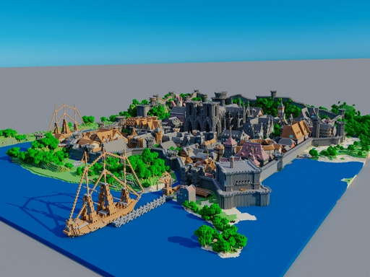
Tinyobjloader: A single-file “.obj” file loader.
A tiny single-header loader for wavefront “.obj” 3D model files.
How to add CMakeLists:
It is a single header library so we only point to it in the “include_directories”.
In one and only one c/cpp file, we must add the define “#define TINYOBJLOADER_IMPLEMENTATION” before we include the library header.
Link: https://github.com/tinyobjloader/tinyobjloader

Slide 25
What if we want to add more libraries?
If we want to add more libraries (for example, audio or physics libraries), it is helpful to follow these hints:
First and foremost, check if the author wrote how to include the library into your project.
Header-only libraries are usually the easiest type to include but can have a negative effect on the compilation speed (lots of code are included in the headers thus recompiled with other files).
Libraries that has a “CMakeLists.txt” can usually be included using “add_subdirectory” but you need to search for the library name for linking (can be found in the “CMakeLists.txt” file).
If it is neither header-only nor a CMake project, then you will need to find the relevant source files and add them manually to you targets (or build a library target for them).

Slide 26
Let’s create a WINDOW !

Slide 27
Application structure
A game application has three main phases:
Initialization Phase
Game
Loop
Phase
Clean up Phase

Slide 28
Initialization Phase
The initialization phase has to do some actions before the game loop start:
Initialize GLFW to use its capabilities.
glfwInit()

Slide 29
Initialization Phase
The initialization phase has to do some actions before the game loop start:
Configure OpenGL.
glfwWindowHint(GLFW_CONTEXT_VERSION_MAJOR, 3);
glfwWindowHint(GLFW_CONTEXT_VERSION_MINOR, 3);
glfwWindowHint(GLFW_OPENGL_PROFILE, GLFW_OPENGL_CORE_PROFILE);
glfwWindowHint(GLFW_OPENGL_FORWARD_COMPAT, GL_TRUE);
Use OpenGL 3.3
Use Core Features only
Removed all deprecated features (For Forward Compatibility)
Notes:
This code is similar in many OpenGL projects so no need to be memorized at all.
Here we are specifying that we want OpenGL 3.3.
By choosing “GLFW_OPENGL_CORE_PROFILE”, we enforce that any features from older OpenGL that is no longer part of the core features of 3.3 will not work. In other words, “No Backward Compatibility”. The other alternatives are “GLFW_OPENGL_COMPAT_PROFILE” and “GLFW_OPENGL_ANY_PROFILE”.
By enabling “GLFW_OPENGL_FORWARD_COMPAT”, we enforce that any features that are deprecated in 3.3 will be removed. This ensures that our code will be forward compatible with newer versions of OpenGL since we can’t use features that have been removed in newer OpenGL versions.

Slide 30
Initialization Phase
The initialization phase has to do some actions before the game loop start:
Configure OpenGL.
//Make window size fixed (User can't resize it)
glfwWindowHint(GLFW_RESIZABLE, GLFW_FALSE);
//Set Number of sample used in MSAA (0 = Disabled)
glfwWindowHint(GLFW_SAMPLES, 0);
Notes:
This code is similar in many OpenGL projects so need to be memorized at all.

Slide 31
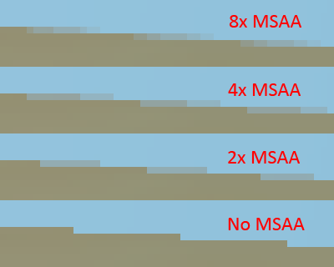
Multisample anti-aliasing (MSAA)
Multisample anti-aliasing (MSAA) is a type of spatial anti-aliasing, a technique used in computer graphics to remove jaggies.
Notes:
Details: https://mynameismjp.wordpress.com/2012/10/24/msaa-overview/

Slide 32
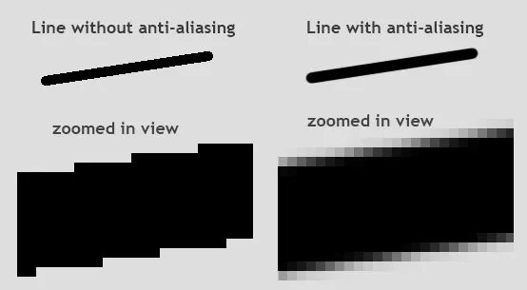
Notes:
Although, when zoomed in, both aliased and anti-aliased images look pixelated, anti-aliasing makes slopes and curves look much smoother and more realistic when there is no zoom (at a decent resolution).
Image Source: https://itigic.com/what-is-anti-aliasing-and-how-does-it-work/

Slide 33
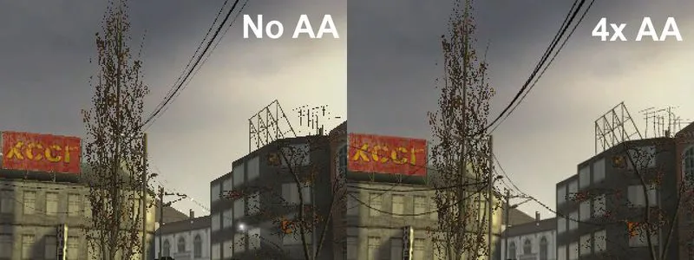
Notes:
It is also very important for rendering extremely thin objects, especially where the thickness can be subpixel (smaller than a single pixel).
Image Source: https://itigic.com/what-is-anti-aliasing-and-how-does-it-work/

Slide 34
Triangle to be rasterized
SCREEN PIXELS
WHY ALIASING HAPPENS

Slide 35
Only 2 possible coverage levels per pixel:
0 samples covered (0% colored).
1 sample covered (100% colored).
Sample Location
NO AA (1 Sample per Pixel)

Slide 36
Only 2 possible coverage levels per pixel:
0 samples covered (0% colored).
1 sample covered (100% colored).
NO AA (1 Sample per Pixel)

Slide 37
Only 2 possible coverage levels per pixel:
0 samples covered (0% colored).
1 sample covered (100% colored).
NO AA (1 Sample per Pixel)

Slide 38
SSAA renders at a higher resolution then downsamples.
Double Resolution
(4x the pixels)
NAIVE SOLUTION: SuperSampling AA (SSAA)

Slide 39
SSAA renders at a higher resolution then downsamples.
Double Resolution
(4x the pixels)
NAIVE SOLUTION: SuperSampling AA (SSAA)

Slide 40
SSAA renders at a higher resolution then downsamples.
Then average each four pixels into one pixel.
NAIVE SOLUTION: SuperSampling AA (SSAA)

Slide 41
NAIVE SOLUTION: SuperSampling AA (SSAA)

Slide 42
Super Sampling Anti-Aliasing (SSAA)
PROS:
Looks great and cures almost all aliasing problem anywhere in the screen.
Is considered the most effective AA technique.
CONS:
TOO EXPENSIVE (We need to run the fragment shaders N times for each pixel).
Notes:
A little piece of trivia: Some (if not all) game companies use SSAA to render promotional material. That’s why some players complain that the game doesn’t look as good as the posters or gameplay trailers.

Slide 43
3 possible coverage levels per pixel:
0 samples covered (0% colored).
1 sample covered (50% colored).
2 sample covered (100% colored).
MSAA:
Run the fragment shader only once per pixel.
Only apply the output color to covered samples.
2x MSAA (2 Samples per Pixel)

Slide 44
3 possible coverage levels per pixel:
0 samples covered (0% colored).
1 sample covered (50% colored).
2 sample covered (100% colored).
2x MSAA (2 Samples per Pixel)

Slide 45
3 possible coverage levels per pixel:
0 samples covered (0% colored).
1 sample covered (50% colored).
2 sample covered (100% colored).
2x MSAA (2 Samples per Pixel)

Slide 46
5 possible coverage levels per pixel:
0 samples covered (0% colored).
1 sample covered (25% colored).
2 sample covered (50% colored).
3 sample covered (75% colored).
4 sample covered (100% colored).
4x MSAA (4 Samples per Pixel)

Slide 47
5 possible coverage levels per pixel:
0 samples covered (0% colored).
1 sample covered (25% colored).
2 sample covered (50% colored).
3 sample covered (75% colored).
4 sample covered (100% colored).
4x MSAA (4 Samples per Pixel)

Slide 48
5 possible coverage levels per pixel:
0 samples covered (0% colored).
1 sample covered (25% colored).
2 sample covered (50% colored).
3 sample covered (75% colored).
4 sample covered (100% colored).
4x MSAA (4 Samples per Pixel)

Slide 49
Multisample anti-aliasing (MSAA)
PROS:
Fast and Hardware supported.
Good result without blurring the whole scene.
CONS:
Extra Memory (Nx MSAA => Nx the memory usage).
Only works on Edges (Doesn’t fix shading aliasing).
Incompatible with Deferred Rendering which is popular in many modern games.

Slide 50
Other popular AA techniques
Some techniques can be applied after the scene is rendered to cure jaggies, such as:
Fast Approximate Anti-Aliasing (FXAA)
Subpixel Morphological Anti-Aliasing (SMAA)
Temporal Anti-Aliasing (TAA)
Deep Learning Super Sampling (DLSS)

Slide 51
Initialization Phase
The initialization phase has to do some actions before the game loop start:
Configure OpenGL.
//Enable Double Buffering
glfwWindowHint(GLFW_DOUBLEBUFFER, GLFW_TRUE);
//Set the bit-depths of the frame buffer
glfwWindowHint(GLFW_RED_BITS, 8);
glfwWindowHint(GLFW_GREEN_BITS, 8);
glfwWindowHint(GLFW_BLUE_BITS, 8);
glfwWindowHint(GLFW_ALPHA_BITS, 8);
Notes:
This code is similar in many OpenGL projects so need to be memorized at all.
Here we enable double buffering.
We also request that each pixel will store each color channel in 8 bits. This means that each pixel will be stored in 4*8=32 bits. Note that not all values of bits are possible, each GPU only supports a few formats so it can select another format if our request is unsatisfiable.

Slide 52
NO DOUBLE BUFFERING
(SLOW MO)

Slide 53
NO DOUBLE BUFFERING
(FAST)

Slide 56
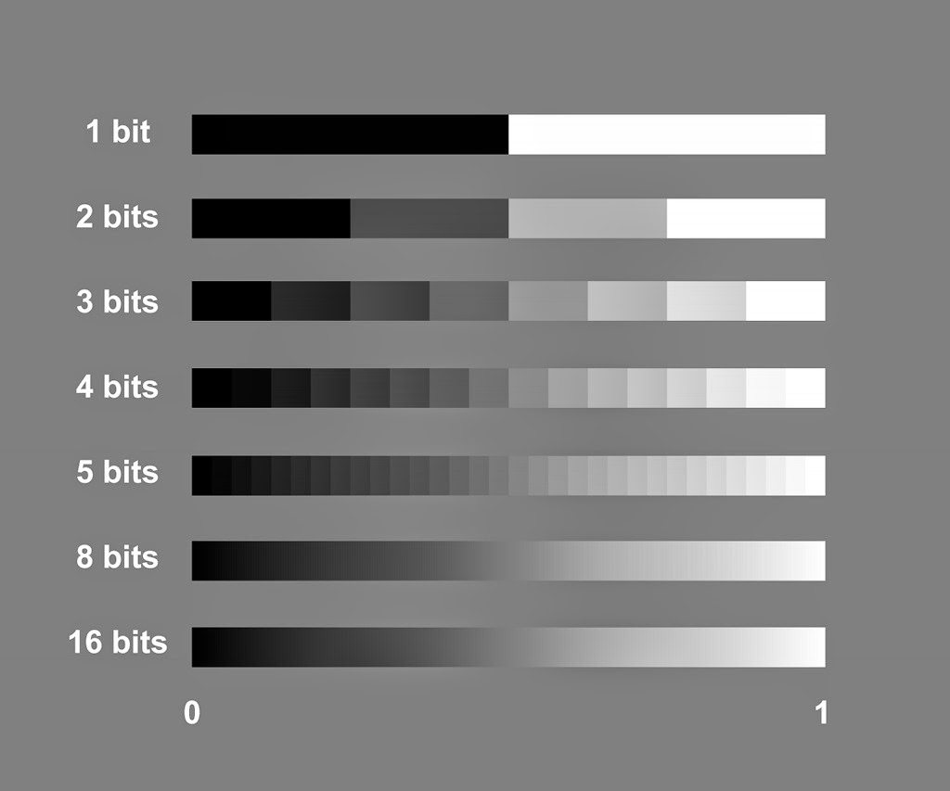
Notes:
Image source: http://www.the-working-man.org/2014/12/bit-depth-color-precision-in-raster.html

Slide 57
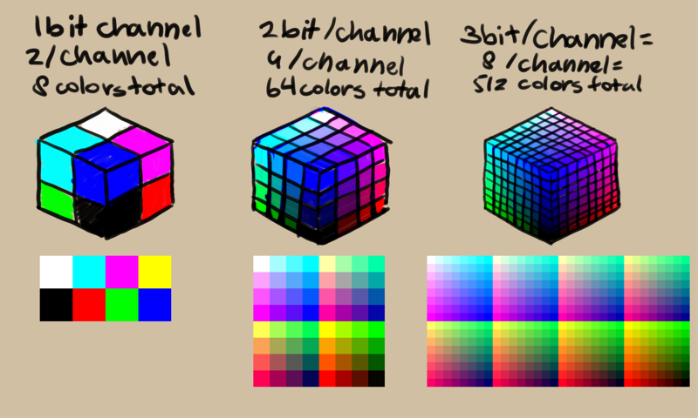
Notes:
Image source: https://docs.krita.org/en/general_concepts/colors/bit_depth.html

Slide 58
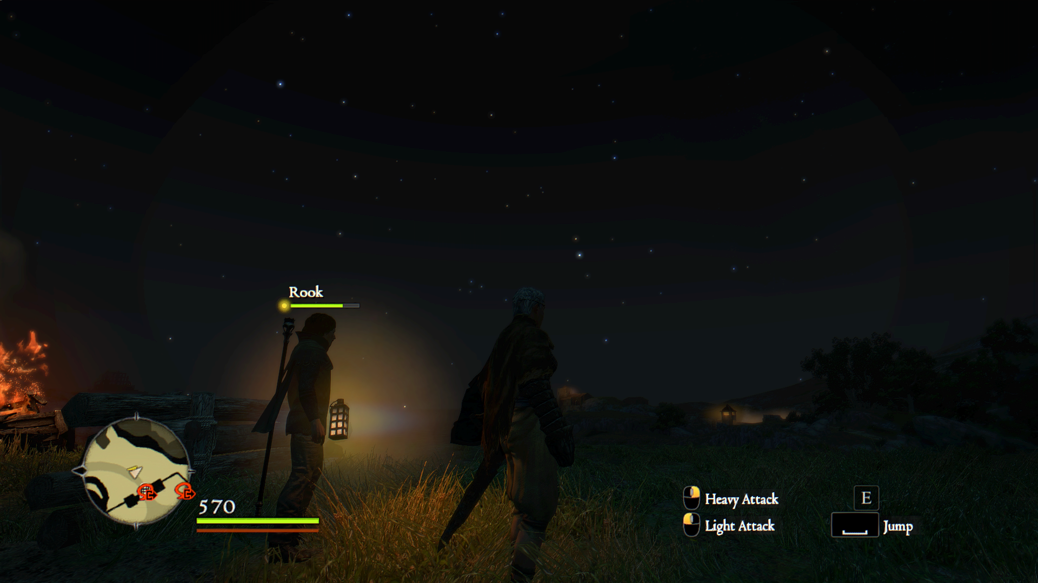
BANDING DUE TO LIMITED BIT DEPTH
Notes:
Image source: https://www.neogaf.com/threads/is-color-banding-a-game-panel-or-driver-issue.1386255/
Even at 8-bit per channel (24-bits per RGB pixel or 32-bits per RGBA pixel), we can still see banding (steps in the color). This is usually apparent in dark scene since we don’t use the full color spectrum (only the dark part of the spectrum is used in the scene).
This is usually solved using a process called Dithering which is beyond the scope of this course (look for dithering in image processing).

Slide 59
Initialization Phase
The initialization phase has to do some actions before the game loop start:
Configure OpenGL.
//Set Bits for Depth Buffer
glfwWindowHint(GLFW_DEPTH_BITS, 24);
//Set Bits for Stencil Buffer
glfwWindowHint(GLFW_STENCIL_BITS, 8);
//Set the refresh rate of the window (GLFW_DONT_CARE = Run as fast as possible)
glfwWindowHint(GLFW_REFRESH_RATE, GLFW_DONT_CARE);
Notes:
This code is similar in many OpenGL projects so need to be memorized at all.

Slide 60
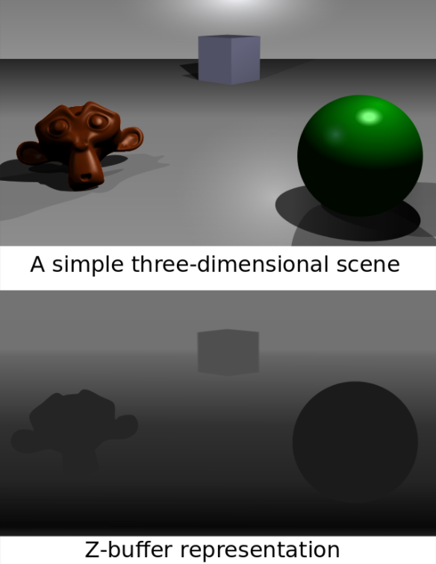
Depth Buffer
Used to store how far a pixel is in the scene. In OpenGL, the further the pixel, the brighter is its depth.
Notes:
Image source: https://en.wikipedia.org/wiki/Z-buffering

Slide 61
Stencil Buffer
Can be used for more any effects such as:
Non-euclidean Rendering
Stencil Shadows/Reflection
Shadow Volumes
Masking in Card Games.
Used by Unity for Deferred Rendering.

Slide 62
Initialization Phase
Recapping the previous initialization slides, we set the configuration through calling:
glfwWindowHint(
What option we want to configure ,
Option from a large enum of possible options prefixed with GLFW
);

Slide 63
Initialization Phase
The initialization phase has to do some actions before the game loop start:
Creating a window.
Or to create a fullscreen window.
The last parameter can be used to share resources between multiple windows, but we will use a single window only.
window = glfwCreateWindow(1280, 720, “Hello OpenGL”, nullptr, nullptr);
window = glfwCreateWindow(1280, 720, “Hello OpenGL”, glfwGetPrimaryMonitor(), nullptr);
Notes:
This code is similar in many OpenGL projects so need to be memorized at all.
First parameter is window width.
Second parameter is window height.
Third parameter is window title.

Slide 64
Make Window the current Context
We need to tell GLFW that we are currently rendering to the window we just created.
This must be done before loading OpenGL.
glfwMakeContextCurrent(window);
Notes:
This code is similar in many OpenGL projects so need to be memorized at all.

Slide 65
Tell GLAD to load OpenGL
GLAD will load the OpenGL functions through the GLFW function “glfwGetProcAddress” which can be used to get pointers to the OpenGL functions.
gladLoadGL(glfwGetProcAddress);

Slide 66
Initialization Phase
The initialization phase has to do some actions before the game loop start:
Setup up call backs (to receive events such as key presses, mouse movement, etc).
Application specific setup (e.g. loading data, creating objects, etc).
Notes:
This code is similar in many OpenGL projects so need to be memorized at all.

Slide 67
Game Loop Phase
The Game loop phase has to do some actions every frame:
Poll user events.
Calculate time taken to draw a frame (delta time).
Draw elements on the frame.
Game logic.
Frame

Slide 68
Game Loop Phase
The Game loop phase has to do some actions every frame:
Poll user events.
Calculate time taken to draw a frame (delta time).
Draw elements on the frame.
Game logic.
Swap buffers.
Previous frame
Frame

Slide 69
Clean up Phase
Application specific on destroy logic.
GLFW destroy window.
Terminate GLFW.

Slide 70
What is the simplest thing to do draw on a screen?

Slide 71
CLEAR IT WITH A SINGLE COLOR

Slide 72
Clear window using OpenGL
First, we define what color to use for clearing. It can be done once if we don’t plan to change the clear color.
Then we clear the color of window.
We can clear other things such as depth and stencil, if we wish.
glClearColor(1.0f, 1.0f, 1.0f, 1.0f);
glClear(GL_COLOR_BUFFER_BIT);

Slide 73
Now let’s draw a triangle.
Introduction to Shaders.

Slide 74
A recap on pointers in C++
POINTER
A pointer is a variable that stores the memory address as its value.
A pointer variable points to a data type (like int or string) of the same type, and is created with the * operator. The address of the variable you're working with is assigned to the pointer.
RAM

Slide 75
The GPU VRAM is not as reachable as the RAM
State (e.g. Vertex Array)
Object name
(unsigned int)
Shader
When asking GL to allocate OpenGL object like:
Memory (Buffer).
Program (Shaders) to draw shapes.
Define a state.
…
It then returns an unsigned int to be used as a identifier (name) to this specific resource.
Buffer
VRAM

Slide 76
Vertex and fragment shaders in the pipeline
Vertex Data
Vertex Shader
Primitive Assembly
Rasterization
Fragment Shader
Frame Buffer
Ironically, we will skip this step for the first few examples

Slide 77
Program
010011001010010110101010100101100100011010101010
010011001010010110101010100101100100011010101010
010011001010010110101010100101100100011010101010
Link
Link
Another
Optional Shader
Vertex Shader
Fragment Shader

Slide 78
Vertex shader
#version 330 core
void main() {
// Create a constant array of data and fill it with data.
const vec3 positions[3] = vec3[3](
vec3( 0.5, -0.5, 0.0),
vec3(-0.5, -0.5, 0.0),
vec3( 0.0, 0.5, 0.0)
);
// Use the vertexID
gl_Position = vec4(positions[gl_VertexID], 1.0);
}

Slide 79
Fragment shader
#version 330 core
// The output of this pixel calculation.
out vec4 frag_color;
void main() {
frag_color = vec4(1.0, 0.0, 0.0, 1.0);
}

Slide 80
How to use shaders in OpenGL?
During initialization:
Create program
For each shader
Create shader
Upload source code
Compile shader
Attach to program
Delete shader (it is no longer needed after attachment)
Link program

Slide 81
How to use shaders in OpenGL?
During drawing:
Use program
Bind vertex array (more details in later labs).
Draw

Slide 82
How to use shaders in OpenGL?
During deinitialization:
Delete program

Slide 83
Create Program
First, we need to create a program that will contain and link the 2 shaders: vertex & fragment shaders.
GLuint program = glCreateProgram();

Slide 84
Create/Upload/Compile/Attach Shader
GLuint shader = glCreateShader(GL_VERTEX_SHADER);
glShaderSource(shader, 1, &source_code_as_c_str, nullptr);
glCompileShader(shader);
glAttachShader(program, shader);
glDeleteShader(shader);
Shader type
A string (char*) contain the source code

Slide 85
Create/Upload/Compile/Attach Shader
GLuint shader = glCreateShader(GL_FRAGMENT_SHADER);
glShaderSource(shader, 1, &source_code_as_c_str, nullptr);
glCompileShader(shader);
glAttachShader(program, shader);
glDeleteShader(shader);
Shader type
A string (char*) contain the source code

Slide 86
Link Program
glLinkProgram(program);

Slide 87
Side Task: Generate a Vertex Array
We will need a vertex array in order to draw anything so let’s create it. This is unrelated to shaders but we have to do it.
GLuint vertex_array;
glGenVertexArrays(1, &vertex_array);
Create 1 vertex array

Slide 88
Draw
glUseProgram(program);
glBindVertexArray(vertex_array);
glDrawArrays(GL_TRIANGLES, 0, 3);

Slide 89
Destruction
glDeleteProgram(program);

Slide 90
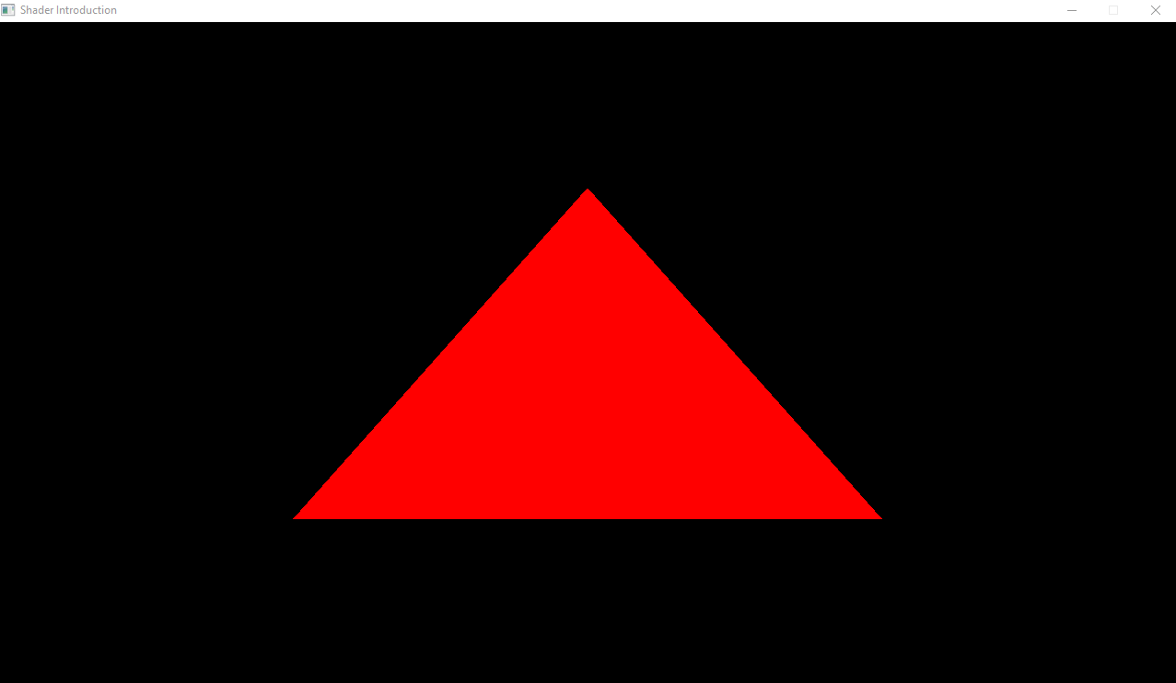

Slide 91
Thank you

